Slide 1
A Comparative Evaluation of Buffer Replacement Algorithms LIRS-WSR and CCF-LRU for Flash Memory Based Systems A Dissertation Work Submitted To: Central Department of Computer Science and Information Technology Tribhuvan University Kirtipur, Nepal Under Supervision of: Prof. Dr. Subarna Shakya, PhD Department of Electronics & Computer Engineering Institute of Engineering Under Co-Supervision of: Mr Arjun Singh Saud Lecturer CDCSIT, TU Submitted by: Mahesh Kumar Yadav (2010-2012, Roll no: 20) CDCSIT, TU

Slide 2
Introduction
Flash memory is non-volatile, shock resistant, and power economic.
Flash memory is now among the top choices for storage media in embedded systems [4].
The I/O cost of read and write operations is significantly asymmetric in flash memory.
The write operation is about 10 times slower than the read operation, and the erase operation is about 20 times slower than the write operation [6, 7, 8].
To improve the performance of flash based systems, we should reduce the frequency of write operation.

Slide 3
Introduction …
The traditional magnetic-disk-based buffering algorithms LRU [9], LIRS [8], ARC [1, 10] etc. focus on hit-ratio improvement alone, but not on write costs caused by the replacement process.
Algorithms LIRS-WSR [6] and CCF-LRU [2] were proposed as new buffering algorithms for flash-based systems. These new flash based buffer replacement policies consider not only buffer hit ratios but also replacement costs incurring when a dirty page has to be propagated to flash memory.
These algorithms favour to first evict clean pages from the buffer so that the number of writes incurring for replacements can be reduced.

Slide 4
LIRS- WSR Algorithm
LIRS-WSR (Low Inter-reference Recency Set – Write Sequence Reordering) algorithm [6] is modification of LIRS algorithm with the application of WSR technique.
The objective of LIRS-WSR is to reduce the number of flushes of dirty pages from the buffer into flash memory when page replacement occurs.
The concepts IRR, Recency, LIR pages, HIR pages, Stack pruning, LIRS stack and HIR queue are same as in original LIRS algorithm.
Additional information cold or not-cold status of each page is recorded.

Slide 5
LIRS- WSR …
When an LIR page is moved from Stack bottom to head of HIR queue, WSR policy is applied.
WSR policy is a second chance policy in which,
The page is checked to find whether it is cold or not.
If it is found not-cold and dirty, then its cold flag is set and moved to top of LIRS stack, next page is checked. Otherwise
The page is moved to the head of HIR queue, switching its status to HIR resident page.
This delays eviction of dirty not-cold pages from buffer to flash memory.
This reduces the number of write operations performed during page replacement.

Slide 6
CCF-LRU Algorithm
CCFLRU [2] (Cold-Clean-First LRU) algorithm is buffer replacement algorithm for flash-based systems which focuses to improve the overall I/O performance by focusing on reducing the write count incurring in the replacement process..
The CCF-LRU algorithm maintains two LRU lists, which are called mixed LRU list and cold clean LRU list. The mixed LRU list contains L1 pages and is used to maintain hot clean pages and dirty pages regardless of the status of its cold flag and the cold clean LRU list with the size of L2 is only for cold clean pages
The first referenced pages are regarded as cold by default, each of which is inserted into the cold clean LRU list with a cold flag.
When the page in the cold clean LRU list is referenced again or becomes dirty, it will be moved from the cold clean LRU list to the MRU position in the mixed LRU list.

Slide 7
CCF-LRU …
When the page in the mixed LRU list is referenced, it will be moved to the MRU position of the mixed LRU list.
The CCF-LRU selects a victim page by the following rules in order:
If the cold clean LRU list is not empty, the LRU page in the cold clean LRU list is selected as the victim; and
If the cold clean LRU list is empty, the LRU page in the mixed LRU list is chosen as the victim candidate. If the candidate is a cold dirty page, it is selected as the victim. If the candidate is a hot dirty page, it is labelled as cold and moved to the MRU position of the mixed LRU list. If the candidate is a hot clean page, it is set to cold and moved from the mixed LRU list to the MRU position of the cold clean LRU list, and we continue to check the LRU position in the mixed LRU list. If there is no victim found after traversing the mixed LRU list, it needs to call the CCF-LRU algorithm one more time to select a victim.

Slide 8
Problem Definition
The replacement algorithm with flash memory should consider not only the hit rate but also the replacement cost caused by selecting dirty victim pages.
The evaluation of the buffer replacement algorithms for flash-based systems in terms of hit rate and write counts is required to compare their performance.
Comparison among several buffer replacement algorithms have been found in different research papers, but comparison between LIRS-WSR and CCF-LRU has not been done yet.
This dissertation work will mainly focus on comparative evaluation of these two algorithms: LIRS-WSR and CCF-LRU.

Slide 9
Objective
The main objective of this dissertation work is:
To perform a comparative analysis of LIRS-WSR and CCF-LRU buffer replacement algorithms for flash based systems in terms of hit rate and write count; and
To evaluate the performance of LIRS-WSR and CCF-LRU.

Slide 10
Literature Review
Traditional Buffer Replacement Algorithms
Buffer Replacement algorithm identifies the victim page and replaces it by fetched page because of lack of primary storage.
Many algorithms have been proposed so far.
Among them, some well-known one’s are:
LRU [9]
CLOCK [22]
LRU-2 [20]
LIRS [8]
Clock Pro [23]
LRFU [2]
Clock-Pro [3]
ARC [1, 10]

Slide 11
Buffer Replacement Algorithms for Flash-Based Systems
Clean First LRU (CFLRU) [11]
Clean First Dirty Clustered (CFDC) [22]
LRU - Write Sequence Reordering( LRU-WSR )[20]
Cold Clean First –LRU ( CCF-LRU ) [23]
Low Inter-reference Recency Set – WSR ( LIRS-WSR ) [5]
Adaptive Double – LRU ( AD-LRU ) [1]

Slide 12
Performance Matrices
The performance of buffer replacement algorithm in flash memory based system is measured in terms of page fault count, miss rate/hit rate and write count.
Miss Rate:
MR = ((#PF - #DP)/(#Ref - #DP))*100
Hit Rate:
HR = 100–MR
Write Count is calculated by counting the number of flushes of dirty pages to flash memory from buffer.
Higher hit rate and lesser number of write counts are the measures for better performance of buffer replacement algorithm.

Slide 13
Program Development
The algorithms have been implemented in C++ programming language using Microsoft® Visual Studio on Intel® Core™ i5-4210U CPU @ 1:7 GHz with 4 GiB RAM Microsoft® Windows 10 1607, 64 bit OS.
The data structure to simulate buffer will be doubly linked list .
Each node of the list will contain appropriate data and pointer fields.

Slide 14
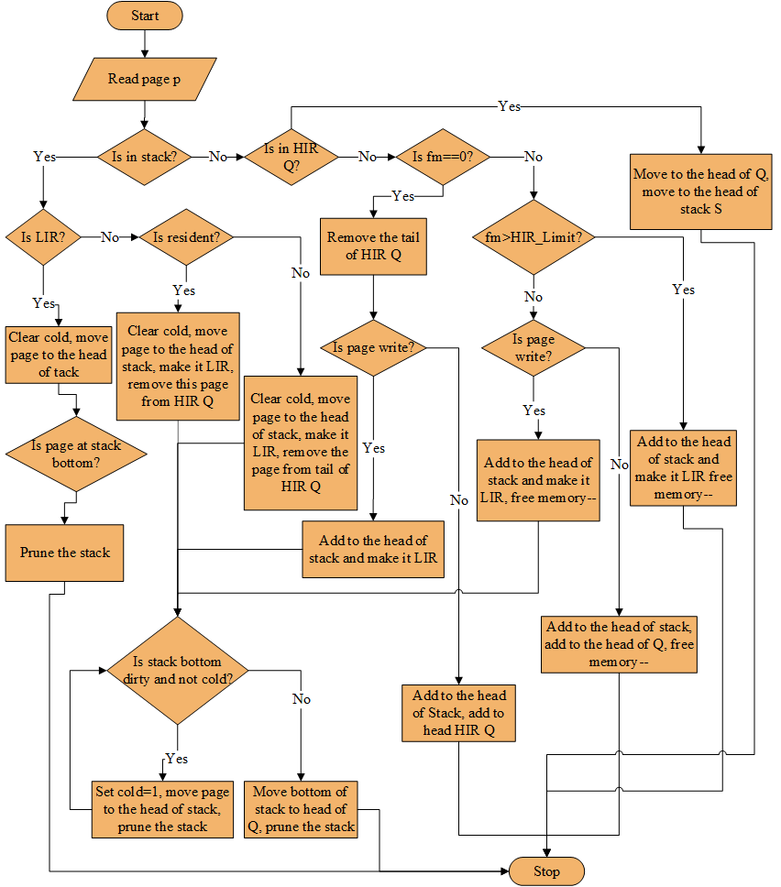
Flow-chart of LIRS-WSR

Slide 15
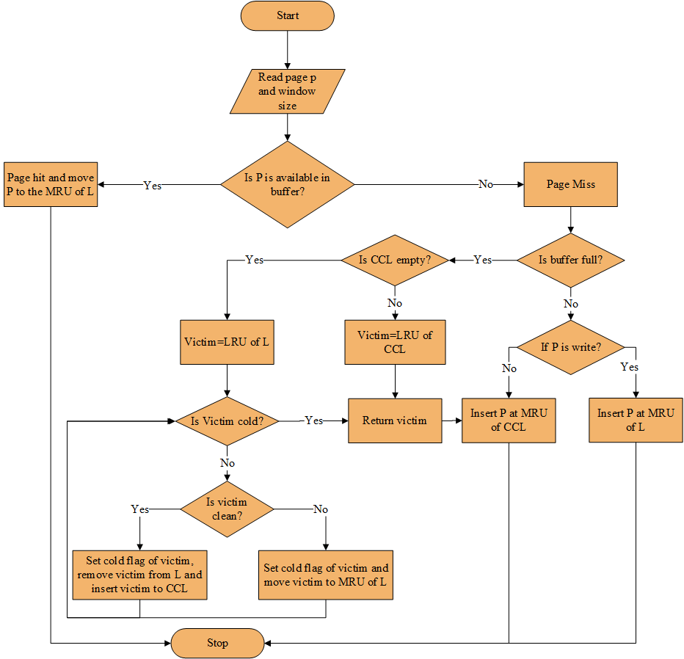
Flow-chart of CCF-LRU

Slide 16
Results, Analysis and Comparison
Input Traces
Four types of memory traces have been used in the simulation.
Random trace (Workload1)
Read- most trace(Workload 2)
Write-most trace (Workload 3)
Zipf trace( Workload 4)

Slide 17
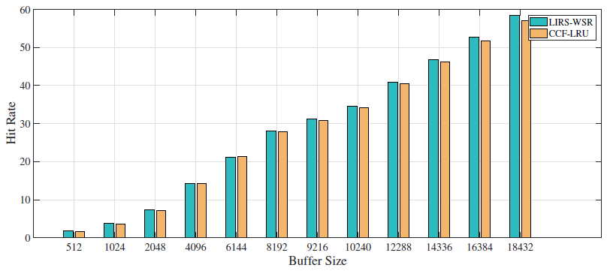
Results, Analysis and Comparison Conti….
Hit Rate Analysis
Graph of Hit Rate for workload 1 with varying buffer size

Slide 18
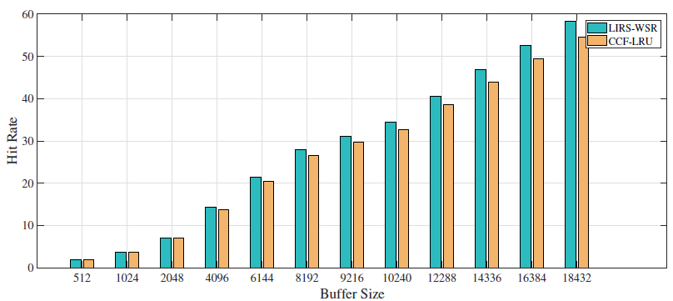
Results, Analysis and Comparison Conti….
Hit Rate Analysis
Graph of Hit Rate for workload 2 with varying buffer size

Slide 19
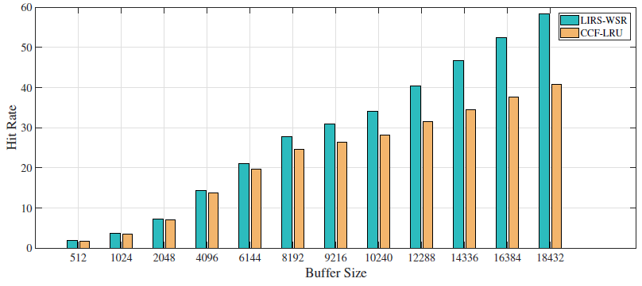
Results, Analysis and Comparison Conti….
Hit Rate Analysis
Graph of Hit Rate for workload 3 with varying buffer size

Slide 20
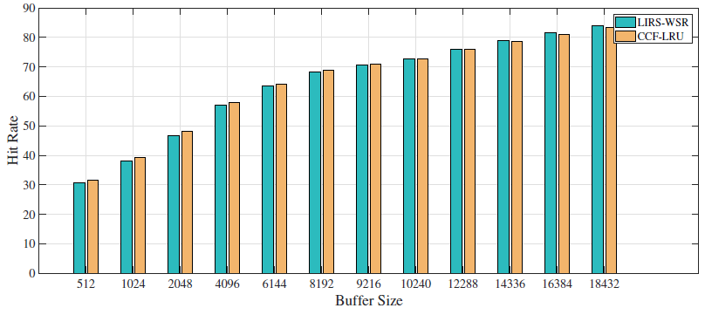
Results, Analysis and Comparison Conti….
Hit Rate Analysis
Graph of Hit Rate for workload 4 with varying buffer size

Slide 21
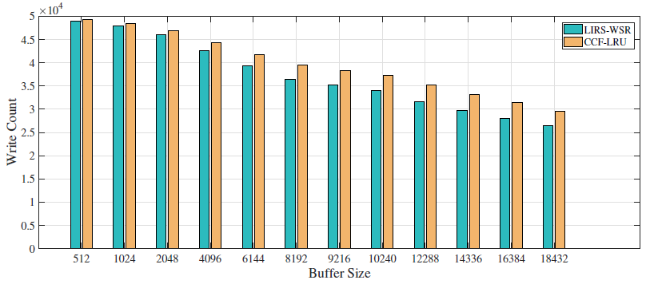
Results, Analysis and Comparison Conti….
Write Count Analysis
Graph of Write Count for workload 1 with varying buffer size

Slide 22
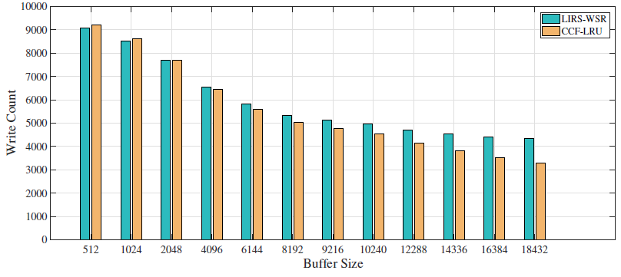
Results, Analysis and Comparison Conti….
Write Count Analysis
Graph of Write Count for workload 2 with varying buffer size

Slide 23
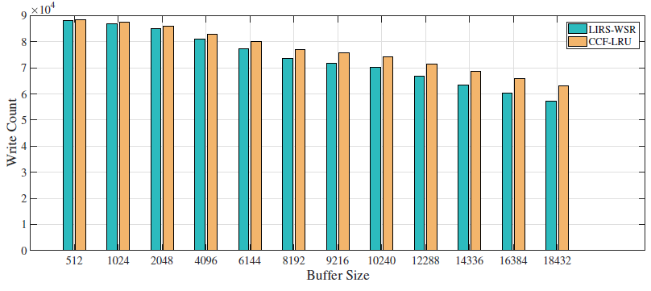
Results, Analysis and Comparison Conti….
Write Count Analysis
Graph of Write Count for workload 3 with varying buffer size

Slide 24
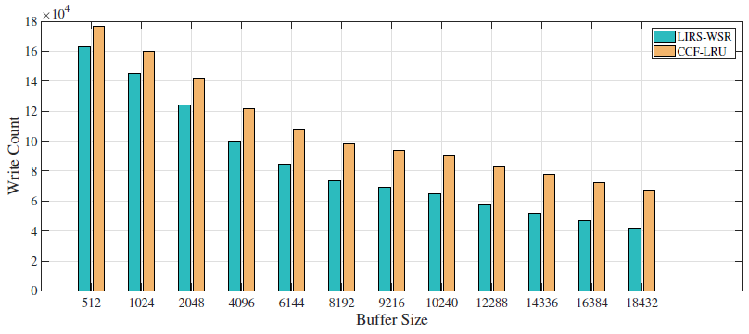
Results, Analysis and Comparison Conti….
Write Count Analysis
Graph of Write Count for workload 4 with varying buffer size

Slide 25
Conclusion
For uniformly distributed workloads, the difference in hit rates of CCF-LRU and LIRS-WSR is comparatively small and LIRS-WSR leads CCF-LRU in hit rate by a value up to 3.8%. For high reference locality workloads LIRS-WSR has significantly higher hit rate up to 17.5% in comparison to CCF-LRU.
For workload 2, for smaller buffer, both algorithm has slightly difference in write count and LIRS-WSR outperforms. As buffer increases, CCF-LRU outperforms LIRS-WSR for read-most trace.
It seems that in case of uniformly distributed write-most access type workload, write count is decreased up to 9.23% by LIRS-WSR, but for high reference locality workload LIRS-WSR minimizes write count up to 37.17% with comparison to CCF-LRU algorithm. Thus, when workload has high reference locality, LIRS-WSR has significantly superior performance than CCF-LRU in terms of both hit rate and write count.

Slide 26
Limitation and Future work
In this work , size of HIR block is chosen 1% of total buffer size in LIRS algorithm and in CCF-LRU algorithm Mixed LRU list and Cold Clean LRU list are divided into two half of buffer size. Dynamic approach can be used to self tune these parameters. Further research can be done to find the optimal value of these parameters for different workloads.
In addition to this, in this work, only four different memory traces have been used for simulation purpose. Three of which are of uniform reference patterns and last one is with 80/20 reference locality. This work can be further extended by using variety of real memory trace with different reference locality.

Slide 27
References
[1] S. Jiang and X. Zhang, “Lirs: An efficient low inter-reference recency set replacement
policy to improve buffer cache performance,” SIGMETRICS Perform. Eval. Rev., vol. 30,
pp. 31–42, June 2002.
[2] Z. Li, P. Jin, X. Su, K. Cui, and L. Yue, “Ccf-lru: A new buffer replacement algorithm for
flash memory,” IEEE Trans. on Consum. Electron., vol. 55, pp. 1351–1359, Aug. 2009.
[3] M.-L. Chiang, P. C. H. Lee, and R.-C. Chang, “Managing flash memory in personal communication devices,” in Consumer Electronics, 1997. ISCE ’97., Proceedings of 1997 IEEE International Symposium on, pp. 177–182, Dec 1997.
[4] L.-P. Chang and T.-W. Kuo, “Efficient management for large-scale flash-memory storage
systems with resource conservation,” Trans. Storage, vol. 1, pp. 381–418, Nov. 2005.
[5] N. Toshiba, “vs. nor flash memory technology overview,” tech. rep., Technical Report,
2006.
[6] H. Jung, K. Yoon, H. Shim, S. Park, S. Kang, and J. Cha, “Lirs-wsr: Integration of lirs and
writes sequence reordering for flash memory,” in Proceedings of the 2007 International
Conference on Computational Science and Its Applications - Volume Part I, ICCSA’07,
(Berlin, Heidelberg), pp. 224–237, Springer-Verlag, 2007.
[7] H.-j. Kim and S.-g. Lee, “A new flash memory management for flash storage system,”
in 23rd International Computer Software and Applications Conference, COMPSAC ’99,
(Washington, DC, USA), pp. 284–289, IEEE Computer Society, 1999.
[8] E. Gal and S. Toledo, “Mapping structures for flash memories: Techniques and open problems,” in Proceedings of the IEEE International Conference on Software - Science, Tech-
nology & Engineering, SWSTE ’05, (Washington, DC, USA), pp. 83–92, IEEE Computer Society, 2005.
[9] A. Silberschatz, P. B. Galvin, G. Gagne, et al., “Memory management strategies,” Operating
System Concept, 8th ed. Wiley Student Edition, pp. 315–417, 2010.
[10] N. Megiddo and D. S. Modha, “Arc: A self-tuning, low overhead replacement cache,”
in Proceedings of the 2Nd USENIX Conference on File and Storage Technologies, FAST
’03, (Berkeley, CA, USA), pp. 115–130, USENIX Association, 2003.

Slide 28
[11] S.-y. Park, D. Jung, J.-u. Kang, J.-s. Kim, and J. Lee, “Cflru: A replacement algorithm
for flash memory,” in Proceedings of the 2006 International Conference on Compilers,
Architecture and Synthesis for Embedded Systems, CASES ’06, (New York, NY, USA),
pp. 234–241, ACM, 2006.
[12] P. Jin, Y. Ou, T. H¨arder, and Z. Li, “Ad-lru: An efficient buffer replacement algorithm for
flash-based databases,” Data Knowl. Eng., vol. 72, pp. 83–102, Feb. 2012.
[13] H. Paajanen, “Page replacement in operating system memory management,” Master’s
thesis, Department of Mathematical Information Technology, University of Jyv¨askyl¨a,
Jyv¨askyl¨a, Finland, October 2007.
[14] B. B. Rawal, “Quantitive Evaluation of Buffer Replacement Algorithms for Flash Based
Systems,” Master’s thesis, Central Department of Computer Science and Information
Technology, Tribhuvan University, Kirtipur, Kathmandu, Nepal, 2014.
[15] A. S. Tanenbaum, Modern Operating Systems. Upper Saddle River, NJ, USA: Prentice
Hall Press, 3rd ed., 2007.
[16] D. Lee, J. Choi, J.-H. Kim, S. H. Noh, S. L. Min, Y. Cho, and C. S. Kim, “On the existence
of a spectrum of policies that subsumes the least recently used (lru) and least frequently
used (lfu) policies,” SIGMETRICS Perform. Eval. Rev., vol. 27, pp. 134–143, May 1999.
[17] Y. Smaragdakis, S. Kaplan, and P. Wilson, “Eelru: Simple and effective adaptive page
replacement,” SIGMETRICS Perform. Eval. Rev., vol. 27, pp. 122–133, May 1999.
[18] D. Lee, J. Choi, J. hun Kim, S. H. Noh, S. L. Min, Y. Cho, and C. S. Kim, “Lrfu (least
recently/frequently used) replacement policy: A spectrum of block replacement policies,”
1996.
[19] G. P. Joshi, “Calculation Of Control Parameter That Results Into Optimal Performance
In Terms Of Page Fault Rate In The Algorithm Least Recently Frequently Used(LRFU)
For Page Replacement,” Master’s thesis, Central Department of Computer Science and
Information Technology, Tribhuvan University, Kirtipur, Kathmandu, Nepal, 2007.
[20] E. J. O’Neil, P. E. O’Neil, and G. Weikum, “The lru-k page replacement algorithm for
database disk buffering,” SIGMOD Rec., vol. 22, pp. 297–306, June 1993.

Slide 29
[21] T. Johnson and D. Shasha, “2q: A low overhead high performance buffer management replacement algorithm,” in Proceedings of the 20th International Conference on Very Large
Data Bases, VLDB ’94, (San Francisco, CA, USA), pp. 439–450, Morgan Kaufmann Publishers Inc., 1994.
[22] F. Corbat´o, “Festschrift: In honor of pm morse, chapter a paging experiment with the multics system, pages 217–228,” 1969.
[23] S. Jiang, F. Chen, and X. Zhang, “Clock-pro: An effective improvement of the clock replacement,” in Proceedings of the Annual Conference on USENIX Annual Technical Conference, ATEC ’05, (Berkeley, CA, USA), pp. 323–336, USENIX Association, April 2005.
[24] S. Bansal and D. S. Modha, “Car: Clock with adaptive replacement,” in Proceedings of the 3rd USENIX Conference on File and Storage Technologies, FAST ’04, (Berkeley, CA, USA), pp. 187–200, USENIX Association, 2004.
[25] A. J. Smith, “Sequentiality and prefetching in database systems,” ACM Trans. Database Syst., vol. 3, pp. 223–247, Sept. 1978.
[26] Y. Ou, T. H¨arder, and P. Jin, “Cfdc: A flash-aware replacement policy for database buffer management,” in Proceedings of the Fifth International Workshop on Data Management on New Hardware, DaMoN ’09, (New York, NY, USA), pp. 15–20, ACM, 2009.
[27] H. Jung, H. Shim, S. Park, S. Kang, and J. Cha, “Lru-wsr: Integration of lru and writes sequence reordering for flash memory,” IEEE Trans. on Consum. Electron., vol. 54, pp. 1215–1223, Aug. 2008.
[28] M. Singh, “Understanding research methodology,” 1991.

Slide 30
Thank You!

